Slide 1
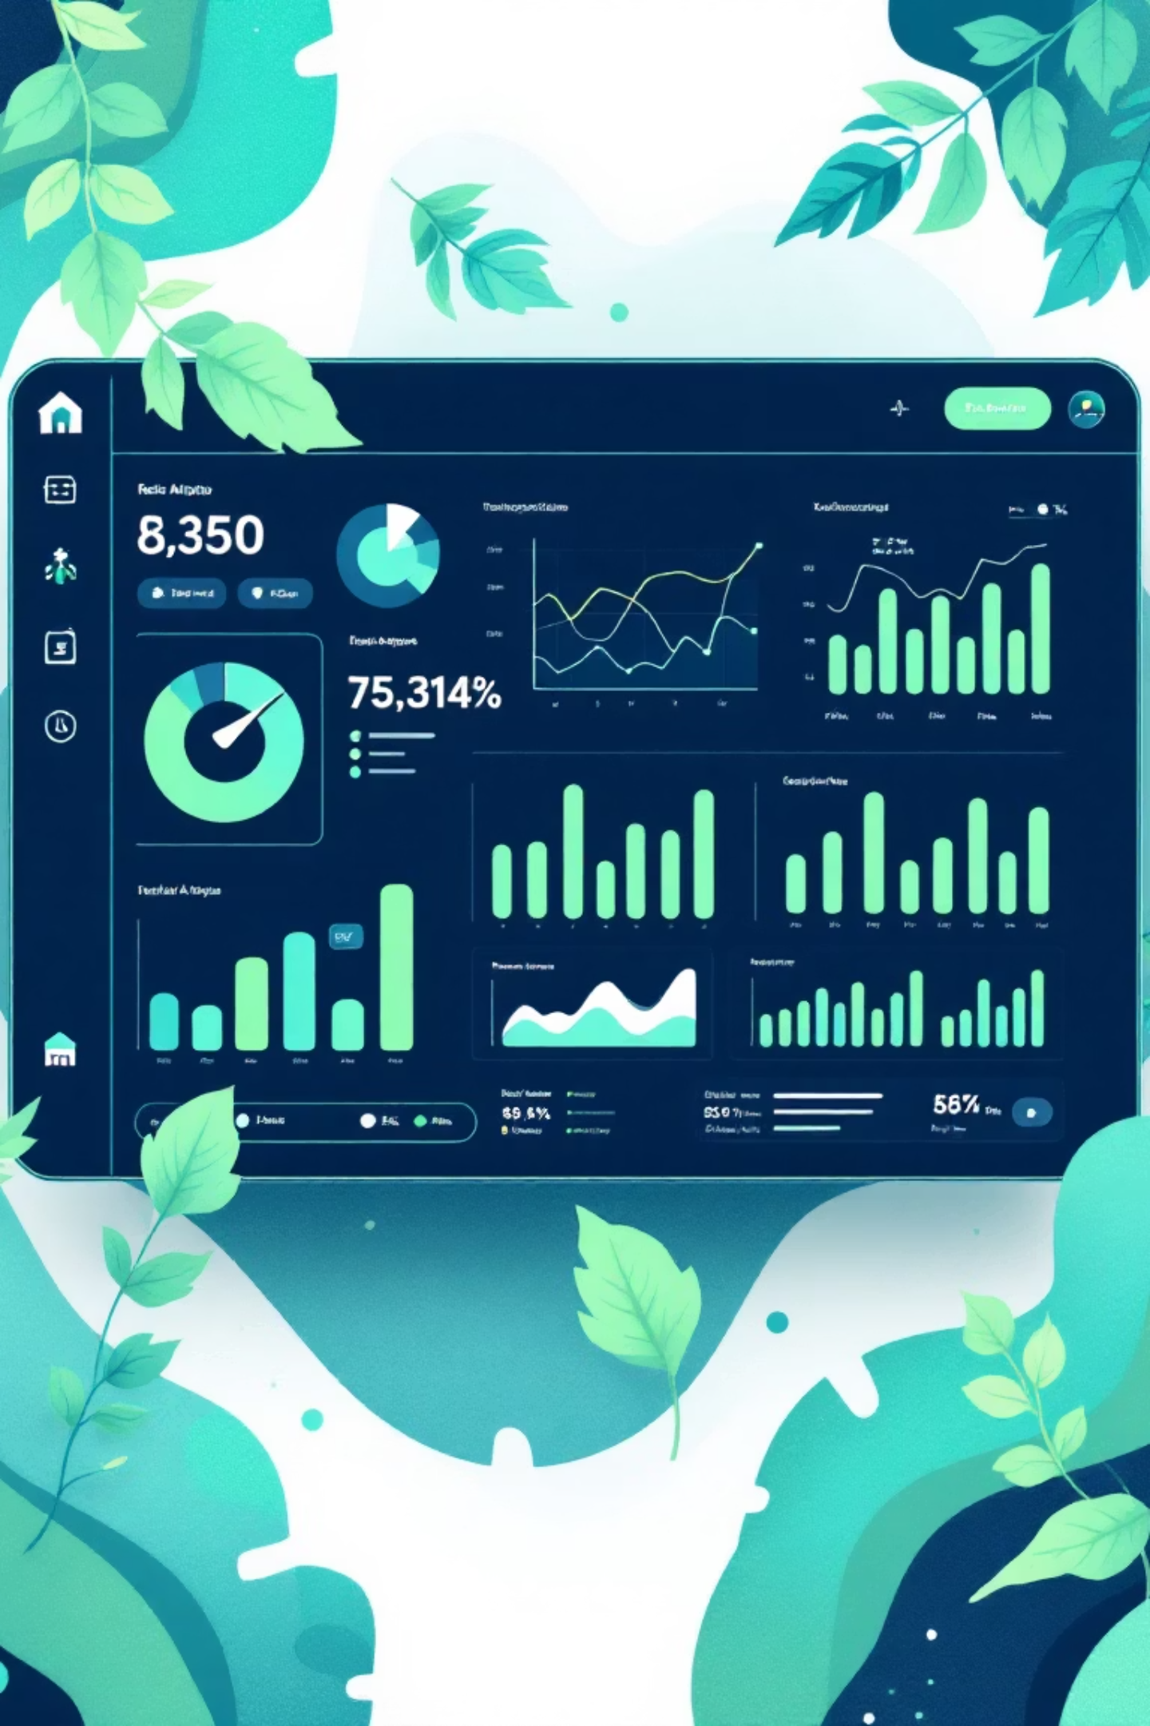
Customer Shopping Behavior Analysis
Understanding purchasing patterns to drive sales, satisfaction, and loyalty

Slide 2

The Challenge
Business Question
Key Focus Areas
How can we leverage consumer shopping data to identify trends, improve engagement, and optimize marketing strategies?
Purchasing patterns across demographics
Product category performance
Online vs. offline behavior
Discount and review impact

Slide 3

Project Scope
Dataset Size
Data Points
3,900 transactions analyzed
18 key features tracked
Analysis Tools
Python, SQL, Tableau
Comprehensive analysis of customer demographics, purchase details, and shopping behavior to uncover actionable insights

Slide 4

Data Preparation Journey
Data Cleaning
Data Loading
Handled 37 missing review ratings using median imputation by category
Imported dataset using pandas, explored structure and statistics
Database Integration
Feature Engineering
Connected to PostgreSQL for advanced SQL analysis
Created age groups and purchase frequency metrics

Slide 5
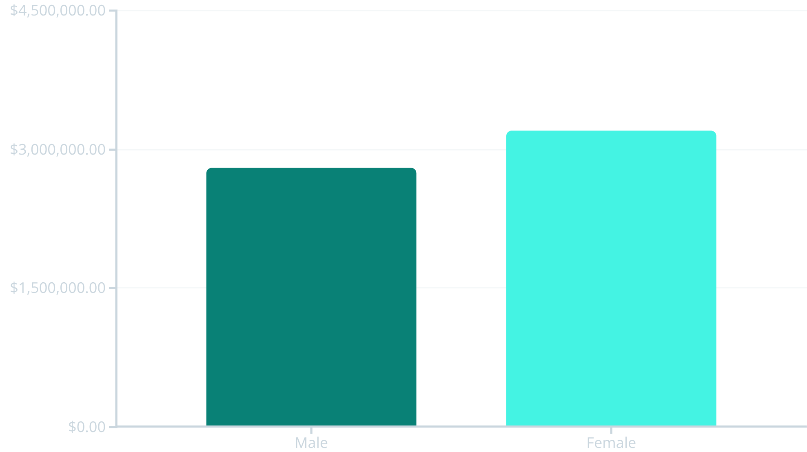
Revenue Insights
Gender Comparison
Female customers generate higher total revenue
Shipping Preference
Express shipping users spend more on average than standard shipping customers

Slide 6



Customer Segmentation
Loyal
1
High-value repeat customers
Returning
2
Regular shoppers building habits
New
3
First-time purchasers
Classification based on purchase history reveals opportunities to move customers up the loyalty ladder

Slide 7

Product Performance
1
2
Top-Rated Products
Best Sellers by Category
Identified 5 products with highest average review ratings
Top 3 most purchased items in each product category
3
Discount-Dependent Items
5 products with highest percentage of discounted purchases

Slide 8

Subscription Impact
Key Finding
Subscribers show higher average spend and contribute significantly more to total revenue
67%
Opportunity to convert loyal customers into subscription members
Repeat Buyers
Customers with 5+ purchases more likely to subscribe

Slide 9
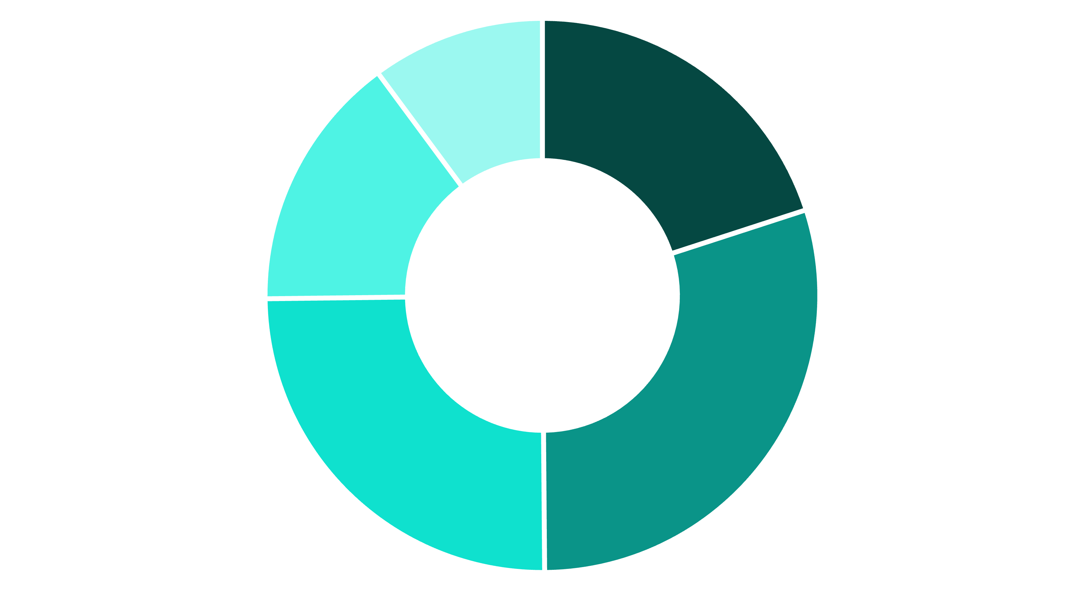
Age Group Revenue Distribution
18-25
26-35
36-45
46-55
56+
26-35 age group drives highest revenue contribution, followed by 36-45 segment

Slide 10
Strategic Recommendations
Boost Subscriptions
Loyalty Programs
Review Discount Policy
Promote exclusive benefits for subscribers
Reward repeat buyers to move them into loyal segment
Balance sales boosts with margin control
Targeted Marketing
Product Positioning
Focus on high-revenue age groups and express-shipping users
Highlight top-rated and best-selling products in campaigns

